Slide 1
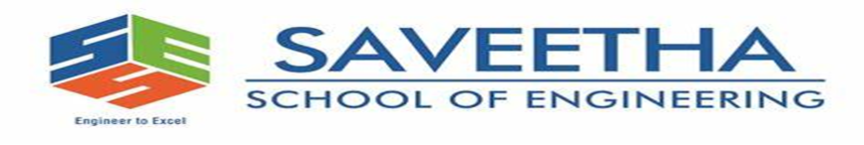

CSA0492-OPERATING SYSTEM FOR THE DYNAMIC STORAGE SYSTEM
MINI PROJECT-MAR 2024
FOR AN APPLICATION OF THE VIRTUAL MEMORY
GUIDE BY:
YUVARANI
PRESENTED BY:
K.MAHENDRA REDDY(192210413)
U.MAHESWARREDDY(192210540)
K.PUSHPAKANTH(192210606)

Slide 2
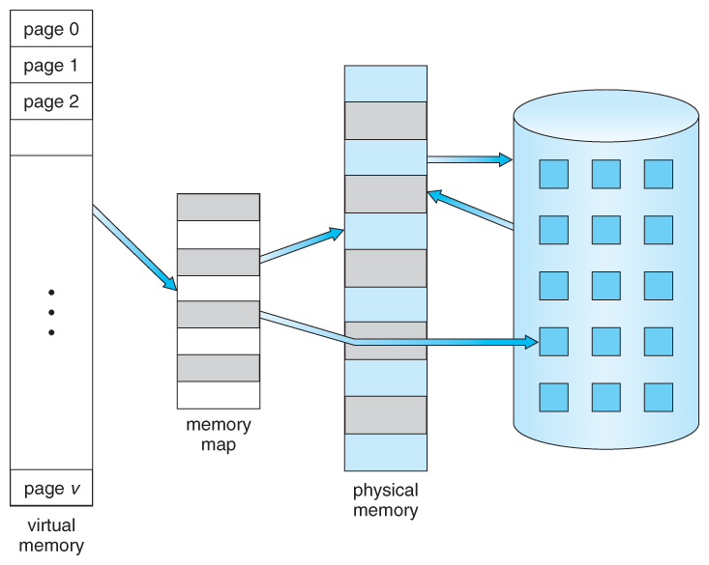
ABSTRACT:
Virtual memory is a memory management technique used by modern operating systems to provide the illusion of a large, contiguous, and private address space to each process, while utilizing the physical memory (RAM) more efficiently.
This technique allows programs to execute as if they have access to more memory than physically available by dynamically swapping data between RAM and secondary storage (usually a hard disk or SSD).
Virtual memory enables multitasking, allowing multiple processes to run concurrently without interfering with each other's memory space. Key components of virtual memory include address translation, page tables, demand paging, and memory swapping algorithms. Overall, virtual memory enhances system performance, reliability, and the ability to handle large and diverse workloads effectively.

Slide 3
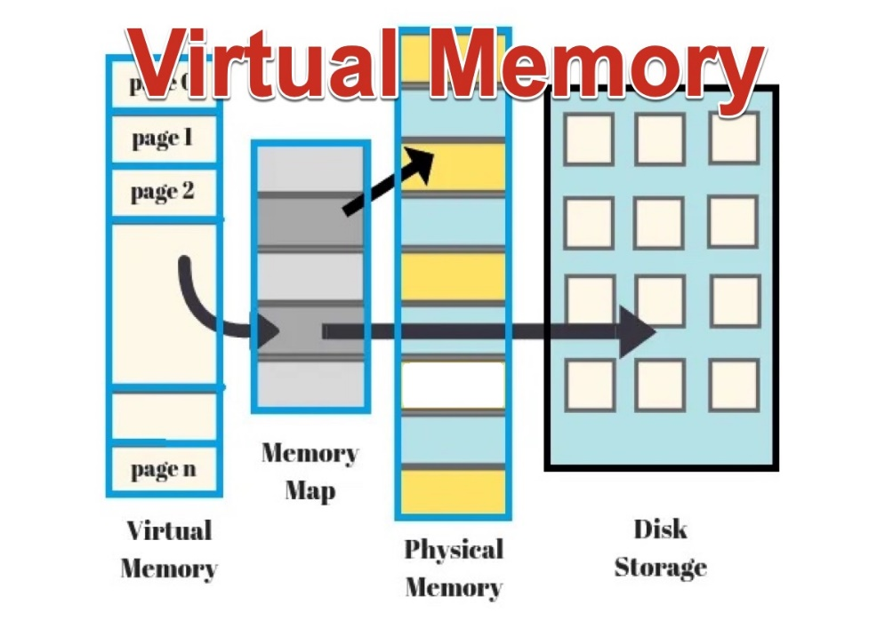
INTRODUCTION:
Virtual memory is a crucial component of modern computer systems, playing a pivotal role in enabling efficient memory management and supporting the execution of multiple processes simultaneously.
It provides a layer of abstraction that allows programs to access a larger address space than physically available memory. This abstraction is essential for multitasking operating systems, where numerous processes compete for limited system resources.
Traditionally, computer systems relied solely on physical memory (RAM) to store and manage data actively used by programs.

Slide 4
OBJECTIVES:
Understanding Virtual Memory Concepts: To elucidate the fundamental concepts underlying virtual memory, including its purpose, operation, and benefits, to provide a comprehensive understanding of its role in modern computing systems.
Exploring Memory Management Techniques: To explore various memory management techniques employed in virtual memory systems, such as demand paging, page replacement algorithms, and memory allocation strategies, to analyze their impact on system performance and resource utilization.
Examining Address Translation Mechanisms: To examine the mechanisms involved in translating virtual addresses to physical addresses, including page tables, TLB (Translation Lookaside Buffer), and address mapping techniques, to understand how virtual memory addresses are managed and accessed.

Slide 5
METHODOLOGY:
▶Literature Review: Review academic papers and technical documentation.
Experimental Analysis: Measure performance using simulation or real-world tests.
Case Studies: Analyze real-world implementations for insights.
Modeling and Simulation: Develop mathematical models and simulations.
Prototyping: Build prototypes to test new ideas.
Benchmarking: Compare performance using standardized benchmarks.
Survey and Interviews: Gather insights from experts and practitioners.

Slide 6
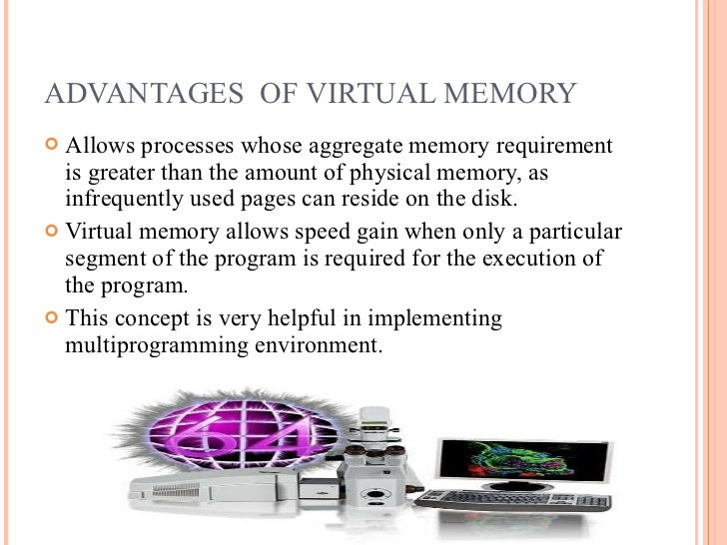
ADVANTAGES
▶

Slide 7
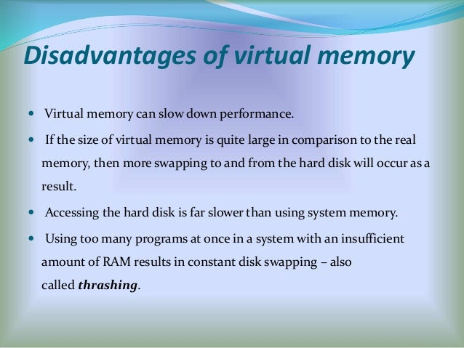

Slide 8
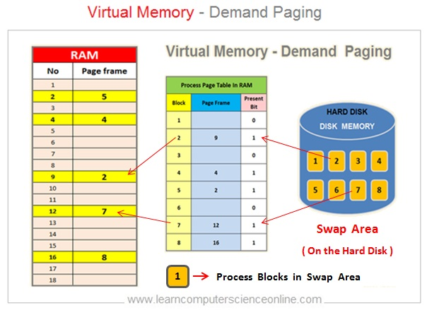
Demand paging :
Demand paging is a memory management technique in virtual where data is brought into physical memory only when it is needed. This approach optimizes memory usage by loading pages into memory on an as-needed basis, reducing the amount of memory required to run programs and improving overall system performance.
Optimizing Memory Usage:
Reducing Memory Footprint
Enhancing Performance

Slide 9
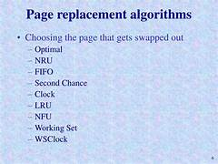

Slide 10
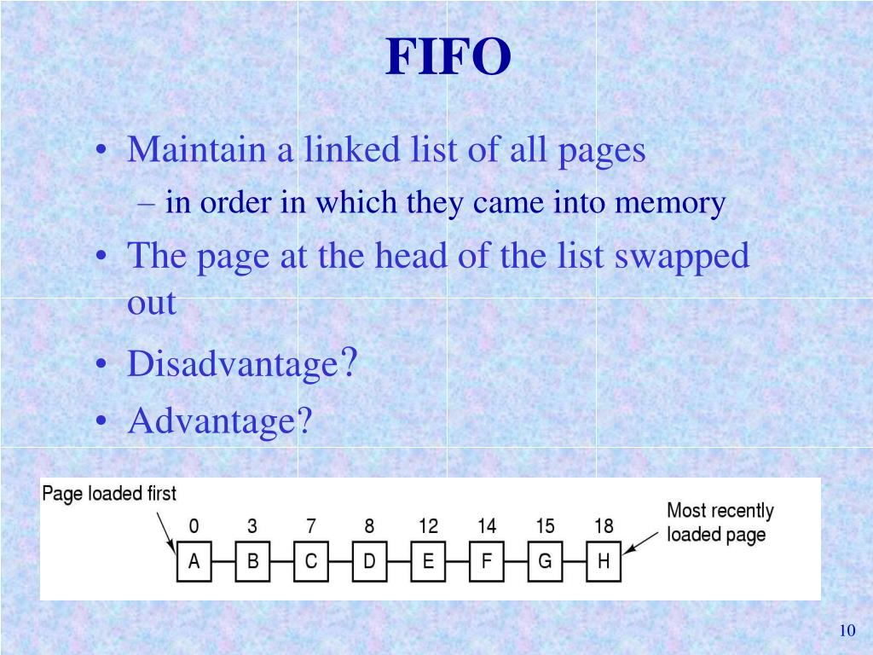
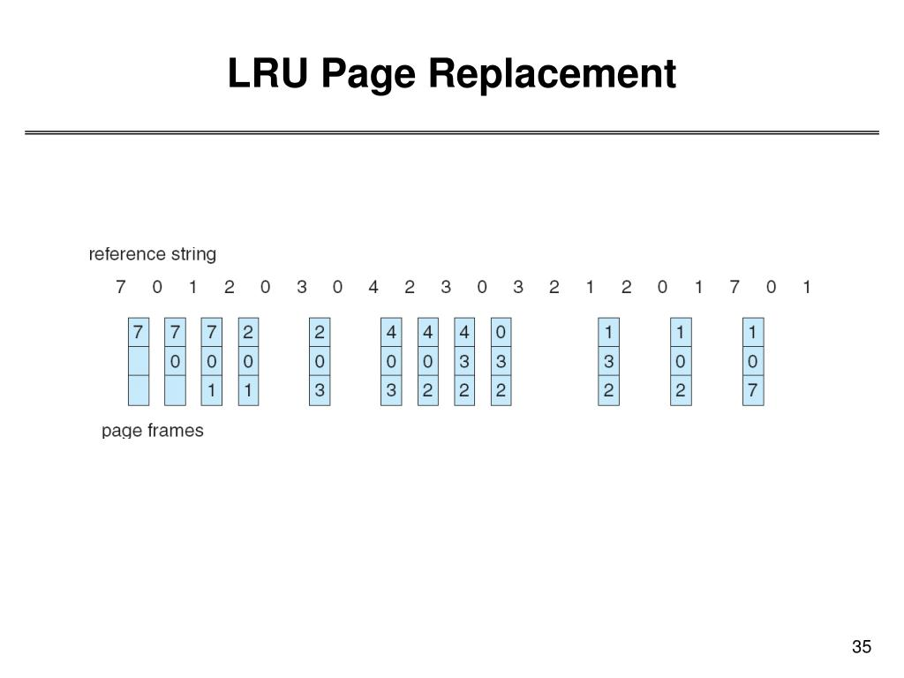
Page replacement:

Slide 11
Problem statement:
The problem statement of virtual memory in operating systems revolves around efficiently managing memory resources to provide a large, contiguous, and private address space to each process, while utilizing physical memory (RAM) and secondary storage effectively. Key challenges include:
Memory Management Overhead.
Page Fault Handling:
Page Replacement Policies:
Fragmentation:.
Concurrency and Synchronization

Slide 12
Conclusion:
virtual memory is a crucial component of modern operating systems, facilitating efficient memory management, multitasking, and scalability.
Despite challenges such as overhead and fragmentation, its benefits in optimizing memory usage and improving system responsiveness remain essential for contemporary computing environments. With ongoing advancements in hardware support and memory management techniques, virtual memory systems will continue to play a vital role in meeting the evolving demands of computing.

Slide 13


